Slide 1
CREATE AN ACCOUNT ON CODEPEN.IO
MID COURSE SURVEY

Slide 2
Front-end web development
snacks & Design
TODAY!
LEO
(Google sheet is pinned in slack)

Slide 3
FEWD
Q & A

Slide 4
“Confused how to set up a Sass file.“

Slide 5
“Is SASS a passing thing like LESS? Do these come and go often?”

Slide 6
INTRO TO PROGRAMMING
Eric Boyer

Slide 7
FEWD
Review

Slide 8
Review
"Lines" (borders) between sections
Background-image
Hover states
Why use anchor instead of button elements?
Shadow on bottom of buttons
Text-transform
Pixels/percentages/responsive
Reuse things like box-shadow

Slide 9
Review — Multiple classes on one element
An element can have multiple classes. Multiple classes are separated by a space in the HTML.
<section class="banner clearfix"></section>

Slide 10

Process

Slide 11
Process
Write your HTML (use HTML5 Flowchart for guidance in picking elements)
Get things into place. (Add floats, clear: both, get columns set up, etc.)
Add base styles. (Font-family/color for the body, remove text-decoration under anchors and add a base anchor color, remove bullets for list items, etc.)
Work through the page section by section and start "filling in the details." Resist the urge to be a perfectionist at this point.
Polish things up! Compare the design with your page. Are you using the right fonts? Colors? Is any of the spacing off?

Slide 12
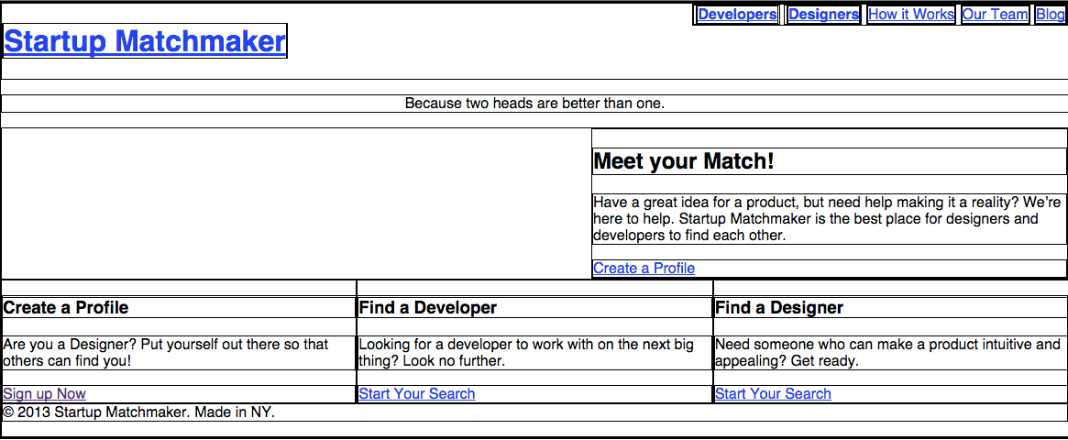
Process — step 2 (layout styles)
*Pro tip: adding a border to everything on the page can help during this process:
* {border: 1px solid black; }

Slide 13
Process
Write your HTML
Get things into place. (Add floats, clear: both, get columns set up, etc.)
Add base styles. (Font-family/color for the body, remove text-decoration under anchors and add a base anchor color, remove bullets for list items, etc.)
Work through the page section by section and start "filling in the details." Resist the urge to be a perfectionist at this point.
Polish things up! Compare the design with your page. Are you using the right fonts? Colors? Is any of the spacing off?

Slide 14
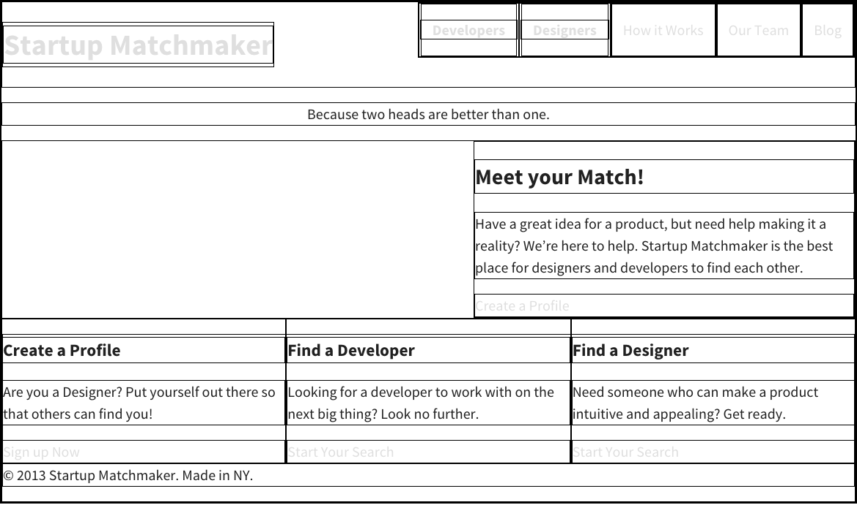
Process — step 3 (base styles)

Slide 15
Process
Write your HTML
Get things into place. (Add floats, clear: both, get columns set up, etc.)
Add base styles. (Font-family/color for the body, remove text-decoration under anchors and add a base anchor color, remove bullets for list items, etc.)
Work through the page section by section and start "filling in the details." Resist the urge to be a perfectionist at this point.
Polish things up! Compare the design with your page. Are you using the right fonts? Colors? Is any of the spacing off?

Slide 16
Learning objectives
Pseudo Code
Practice programmatic thinking by writing pseudo code to solve a basic problem.
Define web site behavior and the practical uses of JavaScript.
Predict DOM output / changes by reading JS code.
Notes:
End by revisiting the learning objectives. This lets students reflect on what they learned and determine if they have any outstanding questions.

Slide 17

Agenda
Q&A
Intro to Programming
Intro to Pseudo Code
Intro to JS
Reading JS
Lab

Slide 18
FEWD
intro to programming

Slide 19
Programming
what is a program?
A program is a set of instructions that you write to tell a computer what to do
what is programming?
Programming is the task of writing those instructions in a language that the computer can understand.

Slide 20
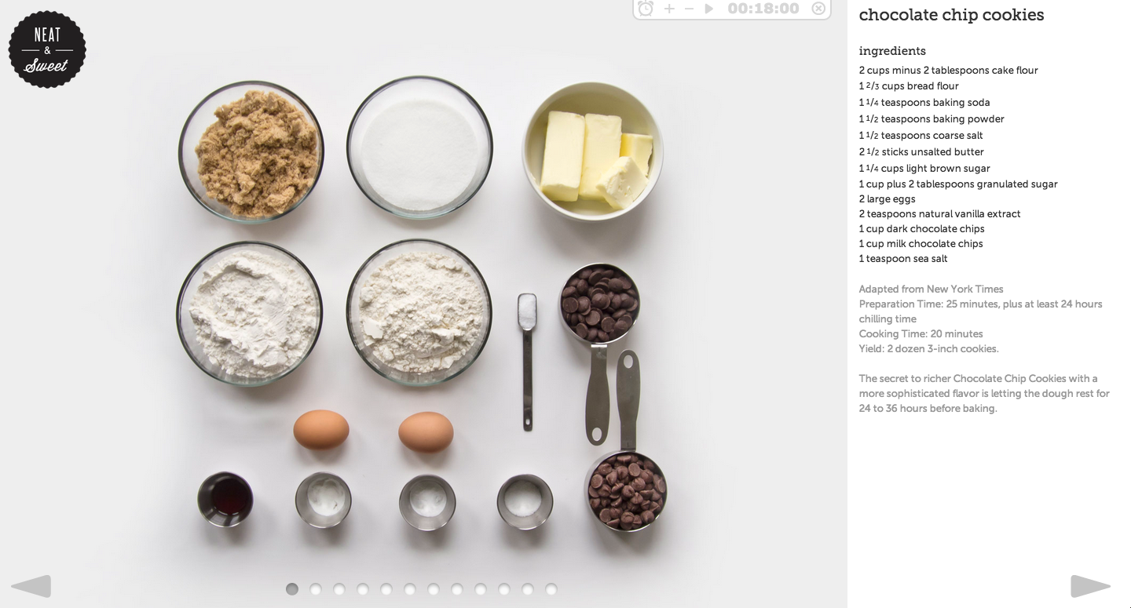
what is a program?
Notes:
By following the steps of a recipe, one-by-one, a person can make something they have never made before.

Slide 21



what is a program?
Notes:
Car mechanics often refer to manuals when servicing car models they're not familiar with.
Often contain a series of tests for a mechanic to check, along with details of how to fix any issues that arise.
Similarly, scripts/programs allow the browser to check the current situation and only perform steps if those are appropriate (logic)

Slide 22
becoming a programmer
It isn't about the programming language!!!
It is about changing how you think.
Notes:
Ruby, Python, etc

Slide 23
how computers 'think'
Short answer — they don’t think!
While computers don’t think, they act as if they do, by sequentially executing simple instructions.
The only things a computer knows are the things we tell it.
A computer doesn't learn to perform tasks like you and I — it needs to follow instructions every time it performs the task.

Slide 24
FEWD
intro to pseudo code

Slide 25
pseudo code
When we write a program, we need to figure out a way to translate the ideas that are in our heads into code
Pseudo code is a way to 'plan out' your program before coding it
Pseudo code is a detailed yet readable description of what a computer program must do, expressed in plain english rather than in a programming language

Slide 26

The importance of planning
Image credit: Minecraft HD Wallpapers

Slide 27

Pseudo Code — thermostat
Goal:
Write pseudo code for an application that would monitor the room temperature and adjust it so the room remains at a certain temperature.
Notes:
White board and walk students through writing a program for that controls a thermostat. Highlight variables, conditionals, and loops.
What is the temp right now?
What do we want the temp to be?
If the current temp is greater than the desired temp, do something
If the current temp is less than the desired temp, do something

Slide 28

Lab — Rock paper scissors

Slide 29

lab — rock paper scissors
key objective
Practice programmatic thinking by writing pseudo code to solve a basic problem
Type of exercise
EXERCISE
Group of 3-4
TIMING
30 min
Write pseudo code to program a computer to play the game 'rock paper scissors'
Write each line of instruction onto a post it
Put the post its in order to form the program
If you finish early, walk around and view what other groups came up with

Slide 30
FEWD
intro to js

Slide 31
The three amigos: Structure, style, behavior
HTML = Noun
CSS = Adjective
Javascript = Verb
Structure
HTML
Style
CSS
Behavior
Javascript

Slide 32


java vs. javascript
Just a quick note! We're learning JavaScript in this class, not Java.
Java and JavaScript are actually two different languages.
!==
Notes:
End by revisiting the learning objectives. This lets students reflect on what they learned and determine if they have any outstanding questions.

Slide 33
What Javascript Can Do!
1
2
3
4
Access
Content
Modify
Content
Program
Rules
React to
Events

Slide 34
What Javascript Can Do!
1
2
3
4
Access
Content
Modify
Content
Program
Rules
React to
Events
You can use JS to select any element, attribute or text from an HTML page.
For example:
Select the text inside all the <p> elements on a page
Select the element that has the id attribute with a value of email
Find out what the user entered into a text input when they submit a form

Slide 35
What Javascript Can Do!
1
2
3
4
Access
Content
Modify
Content
Program
Rules
React to
Events
You can use JS to add elements, attributes and text to the page (or remove them)
For example:
Add an error message below a form
Change the size, position, color, or other styles for an element
Add or remove a class from elements to trigger new CSS rules for those elements

Slide 36
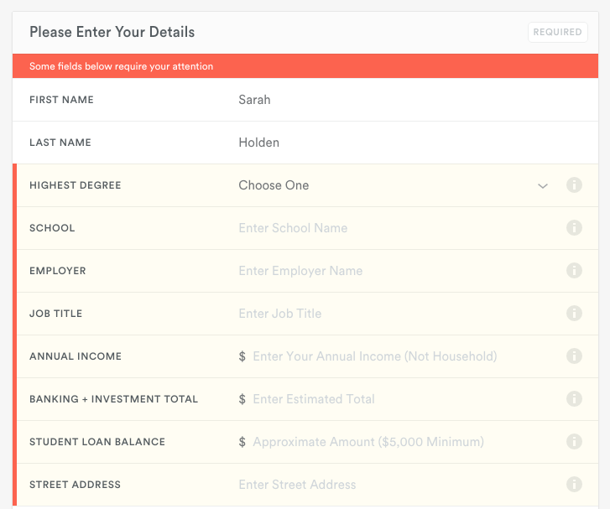
What Javascript Can Do - Modifying content
Add an error message (and styles) to a form
Notes:
Add an error message below a form

Slide 37
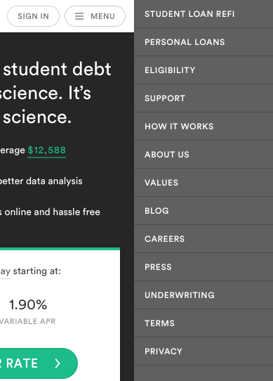
What Javascript Can Do - Modifying content
Change the size, position, color, or other styles for an element
Notes:
Change the size, position, color, or other styles for an element

Slide 38
What Javascript Can Do!
1
2
3
4
Access
Content
Modify
Content
Program
Rules
React to
Events
You can specify a set of steps (instructions) for the browser to follow.
For example:
Have images/text fade in as the user scrolls down the page
Check to make sure the user has entered a valid email address into a form and display an error message if not
Open a chat panel when the user clicks on a 'Chat with Us' button
Filter data when the user selects a filter

Slide 39
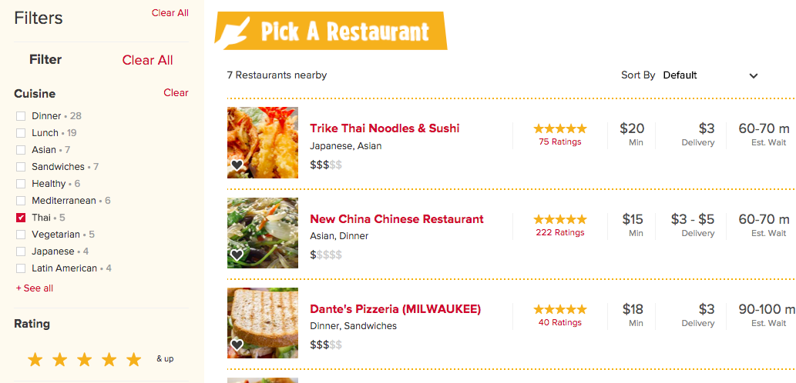
What Javascript Can Do - Program rules
Filter data when the user selects a filter
Notes:
Change the size, position, color, or other styles for an element

Slide 40

What Javascript Can Do!
1
2
3
4
Access
Content
Modify
Content
Program
Rules
React to
Events
You can specify that a script should run when an event occurs
For example:
When a button is clicked
When the cursor hovers over an element
When the user types information into a form
When a page has finished loading
When the user hits enter to submit a form

Slide 41
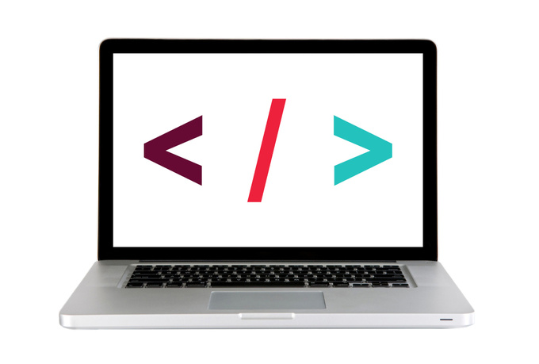
Let's take a look
https://kinhr.com/

Slide 42
FEWD
reading js

Slide 43



Reading JS
When you are a child you learn to speak and read before you learn to write
We learned to 'speak' JS with the discussion, video, and pseudo code

Slide 44
Reading js — Color Switcher walk through
Color Switcher CodePen
Notes:
JS "listens / observes" for when the user clicks on a list item with the id "x" (.onclick and select element by id).
It then calls this block of code. (functions)
This block tells JavaScript to, "change the background color to..."
Now ask questions to check for understanding (e.g. What would I do if I wanted to change the yellow button to red and change the background to red when its clicked)?

Slide 45
Lab — Traffic light

Slide 46
lab — Traffic Light
key objective
Predict DOM output / changes by reading JS code.
Type of exercise
Partner
EXERCISE
TIMING
30 min
Take a look at the Traffic Light code in Codepen
The yellow button changes the bulb to purple and the green light does not work.
Make some minor changes to the code so that the traffic light works correctly.

Slide 47
FEWD
wireframes

Slide 48
getting started
IDEA
PROTOTYPE
DESIGN
CODE
FIND A COMPELLING PROBLEM:
What problem are you solving? And for whom?
How is your “customer” solving this problem now?
Why is your proposed solution better?

Slide 49
getting started
IDEA
PROTOTYPE
DESIGN
CODE
A PICTURE IS WORTH 1000 WORDS:
How will users most likely access my site?
What type of content/information is most valuable? How will I structure things in a way that users will be able to easily find the most important information?
How will users navigate the site? Will it be a single-page or multi-page site?
What types of organizational structures are possible?

Slide 50
getting started
IDEA
PROTOTYPE
DESIGN
CODE
FILL IN THE DETAILS:
I often find it helpful to create a "styleguide" for the site
Pick 4-5 colors for the site
Look through Google Fonts/Font Squirrel and pick out 2-3 fonts for the site
Use sites like https://unsplash.com/ for high-resolution stock images
Sites like http://www.siteinspire.com/ , http://www.awwwards.com/ and http://www.webdesign-inspiration.com/ are great for inspiration!

Slide 51
getting started
IDEA
PROTOTYPE
DESIGN
CODE
PLAN MORE, CODE LESS:
Create a features/functionality list
Start with the structure (HTML), then add styles (CSS), then work on interactions (pseudo code and JavaScript).

Slide 52
Learning objectives
Pseudo code
Practice programmatic thinking by writing pseudo code to solve a basic problem.
Define web site behavior and the practical uses of JavaScript.
Predict DOM output / changes by reading JS code.
Notes:
End by revisiting the learning objectives. This lets students reflect on what they learned and determine if they have any outstanding questions.

Slide 53
Front-end web development
snacks & Design
WED
LAURA
(Google sheet is pinned in slack)

Slide 54
pseudo code
Exit Tickets

